Slide 1
Cloud Computing
The main objective of this course is to provide the introduction to cloud computing. It also discusses the state of art of the cloud computing and the related research areas.
Dr. Manish Pokharel

Slide 2
Lecture 1
Introduction to Cloud Computing

Slide 3
Course Contents
Introduction [6 hrs]
Introduction to Cloud Computing
The evolution of Cloud Computing
State of Arts of Cloud Computing
Features of Cloud Computing
Challenges of Cloud Computing
Cloud Service Delivery Model [6 hrs]
Introduction to types of Cloud Services
Software as a Service (SaaS)
Platform as a Service ( PaaS)
Infrastructure as a Service ( IaaS)
Other Services such as ( DaaS, XaaS etc)

Slide 4
Course Contents…
Cloud Deployment Model [6 hrs]
Introduction to Cloud Types
Private Cloud
Public Cloud
Hybrid Cloud
Community Cloud
Cloud Technologies[9 hrs]
Introduction to Cloud Technology
Virtualization
Service Oriented Architecture(SOA)
Cluster Computing
Grid Computing
Distributed Computing

Slide 5
Course Contents…
Cloud Security[6 hrs]
Introduction to Information Security
Cloud Security
Infrastructure Security
Data Security and Storage
Security Management in Cloud
Security -As -A Service
Cloud Performance[6 hrs]
Service Availability
Reliability
Fault Tolerance
Case Study and Paper Reading[ 6 hrs]

Slide 6
Text Books
Furht Borko, Handbook of Cloud Computing, Springer, 2010, First Edition
Mather Tim, Kumarswamy Subra, LAtif Sahed, Cloud Security and Privacy, O’Rielly, 2009, First Edition

Slide 7
Evaluation
S.N. | Items | In %
1. | Assignment | 20%
2. | Mid Term Exam | 20%
3. | Presentation | 10%
4. | Final Exam | 50%

Slide 8
If not then let’s start…
Any Query???

Slide 9
Introduction
There was a huge expectation from user’s community to get the resources whenever they need.
People were expecting the computing facilities and resources on demand.
The birth of cloud computing gave the light on it and finally it has become possible to address such expectations.
Cloud computing is a novice approach in which every required resources are provided from one end to the other.

Slide 10
What is Cloud Computing?
An Internet-based or intranet based computing environment wherein computing resources are distributed across the network (i.e.; the “cloud”) and are dynamically allocated on an individual or pooled basis as circumstances warrant, and are increased or reduced as circumstances warrant, to handle the computing task at hand” (Courtesy , Harry Newton, Newton’s Telecom Dictionary, 24th Ed.)

Slide 11
Now, Again!!!
The rapid change in technology, frequent updates in users’ demand ,associative high cost in managing users’ demand and available technology have been big challenges in the history of computing.
The disparity in the cost of hardware and software has made the big obstacles in computing.
Buying the required infrastructures, operating it and upgrading it are the great issues in computing field.

Slide 12
Continue…
The users’ community was worried and expecting something miracle to overcome these challenges.
They were expecting the computing facilities and required resources should be available on demand like other utility facilities.
Their expectations have been addressed by cloud computing where computing is treated as a utility and computing facilities would be provided on demand.

Slide 13
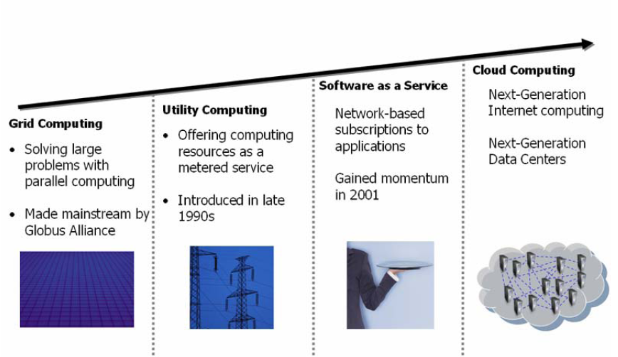
Evolution of Cloud Computing

Slide 14
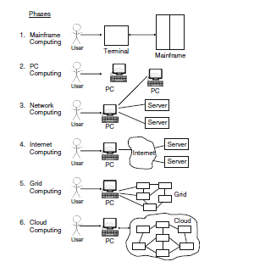
Computing Paradigms

Slide 15
What is Cloud Computing?
A cloud computing is the type of parallel and distributed system consisting of a collection of inter-connected and virtualized computers that are dynamically provisioned and presented as one or more unified computing resources based upon the service level agreements [SLA] established through negotiation between service provider and service user.

Slide 16
Cloud Computing Again!!!
A large scale distributed computing paradigm that is driven by economies of scale, in which a pool of abstracted, virtualized, dynamically-scalable, managed computing power, storage platforms, and services are delivered on demand to external customers over the Internet ( Foster et al- 2008)
What are the two important aspects in above definition?
Virtualization and Scalability

Slide 17
What is cloud computing?
Cloud computing is very new concept of computing.
It has been thought and realized as a future generation of computing with the promise of revolutionizing the ICT services by transforming computing into a ubiquitous utility.
It is the computing in cloud where as the cloud refers to virtual servers; distributed hosting, and shared resources available over Internet.
The users can access the cloud for available service through the web browser and Internet connectivity.
The main theme of cloud computing is to provide the resources as a utility to the users.

Slide 18
Finally, Vaquero et al. (2008) analyzed no less than 22 definitions of Cloud Computing, all proposed in 2008. Based on that analysis, Vaquero et al. (2008) propose the following definition which aims to reflect how Cloud Computing is
currently conceived:
“Clouds are a large pool of easily usable and accessible virtualized resources (such as hardware, development platforms and/or services). These resources can be dynamically reconfigured to adjust to a variable load (scale), allowing also for an optimum resource utilization. This pool of resources is typically exploited by a pay-per-use model in which guarantees are offered by the Infrastructure Provider by means of customized SLAs.”

Slide 19
Continue…
The main goal of cloud computing is to provide ICT services with shared infrastructure and the collection of many systems. In cloud computing every facility is provided in term of service.
Let’s try to understand cloud computing with OO concept.

Slide 20
Continue…

Slide 21
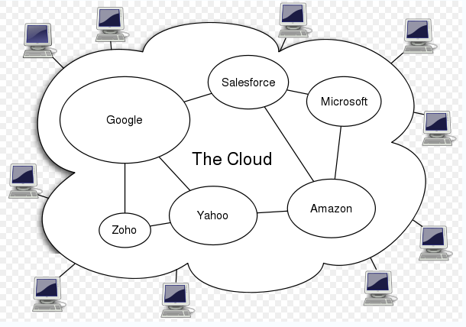
Architecture of cloud computing system

Slide 22
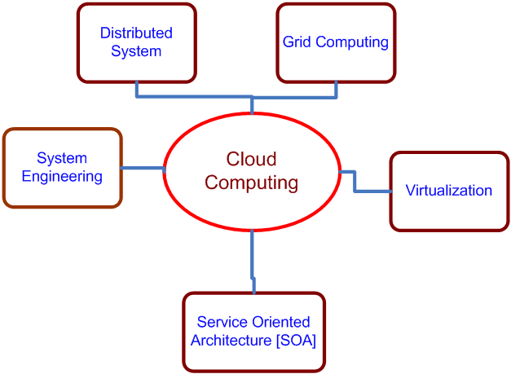
Cloud Computing Technology
Cloud computing isn’t so much a technology as it is the combination of many preexisting technologies.

Slide 23
Let’s see !!!
The “Cloud Computing” as referring to a seamless component-based architecture that can deliver an integrated, orchestrated and rich suite of both loosely and tightly coupled on-demand information technology functions and services, significantly reduce overhead and total cost of ownership and services, and at the same time empower the end-user in terms of control

Slide 24
Features of Cloud Computing
Scalability
Low Risk
Reliability and Survivability
Availability
Low Cost
Ubiquitous Network
Some more identified advantages of cloud computing are server consolidation, hardware abstraction via virtualization, better resource management and utilization, service reliability and availability, improved security and cost effectiveness.

Slide 25
What is server consolidation?
Server consolidation is an approach to optimizing computing resources that recognizes individual servers typically have excess capacity during the course of their normal operations.
Server consolidation aims to optimize the use of physical resources to minimize underutilization.
Server consolidation may entail the introduction of server virtualization technologies as a mechanism for optimizing server capacity.

Slide 26
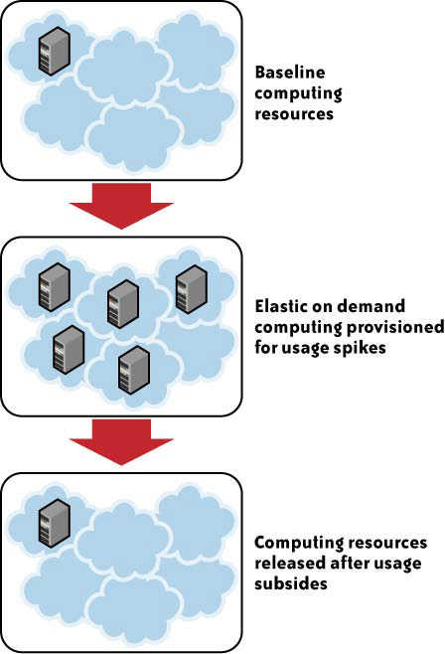
Example : Scalability

Slide 27
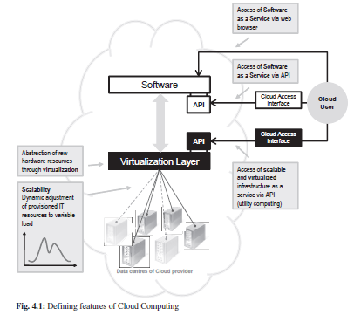

Slide 28
Why do we need cloud computing ?
Cost
Development cost: It is the cost that requires making master plan, building infrastructure, buying hardware, buying software, making database, building security mechanism etc.
Operating cost: it is the cost of operating the system. It includes the cost for electricity, cooling system, hiring manpower all the time, paying software license, network cost etc.
Maintenance Cost: It is cost of maintaining the system. System life time is large and system is cyclic in most of the system. Software has to be modified, updated, and changed frequently. Hardware has to be replaced, configuration has to be changed.
The cost that is required in these activities belongs to maintenance cost.
It is well known that maintenance cost is more than development cost.

Slide 29
Continue…
Expertise
Experts from different domains are required to be involved in design, development, implementation and maintenance of any system. The experts are not only involved in design and development phase.
It is required throughout the life cycle of system.
There is a big problem in managing all these experts; especially in the developing countries it is next to impossible but the cloud computing has the capacity to manage all the required expertise.
Maintenance
In any complex system there are huge involvements of software, hardware, networking, security etc.
As per the cyclic nature of system life cycle, the replacement and updating of all these software and hardware are very much required and moreover maintaining datacenter in every city is very big challenges.

Slide 30
Continue…
Green ICT
The use of ICT devices is increasing very rapidly. In a system, we can find thousands of PCs, a huge number of sophisticated servers, printers, scanners, digitizers etc in a single organization.
What is the effect of using such devices in environment?
Each PC in use generates about a ton of carbon dioxide every year.
The energy consumption by each PC is also very high.
These problems promote the global warming which has become one of the big threats for everyone.

Slide 31
Continue…
Energy consumption of data centers is becoming a key concern for their owners: energy costs(fuel) continue to rise and Carbon di-Oxide emissions related to this consumption are relevant.
In 2007, Gartner [1] estimated that the global impact of the ICT sector (considering PCs, servers, cooling, fixed and mobile telephony, local area network, office telecommunications and printers) is 2% of the global CO2 emissions, which is approximately the same as fuel consumption from the airline industry.

Slide 32
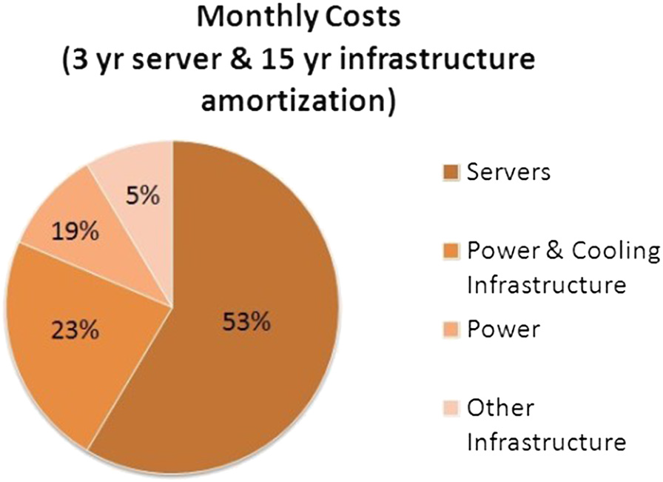
Amazon’s monthly expenses distribution.
Amazon’s evaluation of its data centre expenses showing that server costs account for 53%, while energy related costs totaling 42%.

Slide 33
Continue…
Therefore, saving money in the energy budget of a data centre, without sacrificing Service Level Agreements (SLA) is an excellent incentive for data centre owners, and would at the same time be a great success for environmental sustainability.
This aspect needs to be highlighted, since it’s absolutely not frequent in environment-related problems to have a solution satisfying all stake holders.

Slide 34
Assignment I
What is Green ICT and how does cloud support Green ICT?

Slide 35
Features of Clouds
Rapid Elasticity:
Elasticity is defined as the ability to scale resources both up and down as needed.
To the consumer, the cloud appears to be infinite, and the consumer can purchase as much or as little computing power as they need.

Slide 36
Continue…
Measured Service:
In a measured service, aspects of the cloud service are controlled and monitored by the cloud provider.
This is crucial for billing, access control, resource optimization, capacity planning and other tasks.

Slide 37
Continue…
On-Demand Self-Service:
The on-demand and self-service aspects of cloud computing mean that a consumer can use cloud services as needed without any human interaction with the cloud provider.
Ubiquitous Network Access:
Ubiquitous network access means that the cloud provider’s capabilities are available over the network and can be accessed through standard mechanisms by both thick and thin clients.

Slide 38
Continue…
Resource Pooling:
Resource pooling allows a cloud provider to serve its consumers via a multi-tenant model.
Physical and virtual resources are assigned and reassigned according to consumer demand.
There is a sense of location independence in that the customer generally has no control or knowledge over the exact location of the provided resources but may be able to specify location at a higher level of abstraction (e.g., country, state, or datacenter).
Multi-tenancy refers to a principle in software architecture where a single instance of the software runs on a server, serving multiple client-organizations (tenants).

Slide 39
Benefits of Cloud Computing
Significant Cost Reduction:
Available at a fraction of the cost of traditional IT services; upfront capital expenditures eliminated; dramatically reduced IT administrative burden
Increased Flexibility:
On-demand computing across technologies, business solutions and large ecosystems of providers; reduced new solution implementation times.

Slide 40
Continue…
Access anywhere:
From a single computer or network.
Use different computer or move to portable devices, and applications and documents follow.
Elastic scalability and pay-as-you-go:
Add and subtract capacity as your needs change.
Pay for only what you use.
Easy to implement:
No need to purchase hardware, software licenses or implementation services.

Slide 41
Continue…
Service quality:
Reliable services, large storage and computing capacity, and 24/7 service and up-time.
Delegate non-critical applications:
Outsource non-critical applications to service providers and focus agency IT resources on business-critical applications.
Always the latest software:
Updates are automatic

Slide 42
Issues in Cloud Computing
Security
Performance
Availability
Hard to integrate
Ability to customize
Higher cost
Regulatory requirements
Not enough major suppliers

Slide 43
What is Cloud Computing?
Essential Characteristics include:
On-demand self-service
Ubiquitous network access
Location independent resource pooling
Rapid Elasticity
Measured Service
Delivery Models include:
Cloud Software as a Service (SaaS)
Cloud Platform as a Service (PaaS)
Cloud Infrastructure as a Service (IaaS)
(Peter Mell and Tim Grance, NIST)

Slide 44
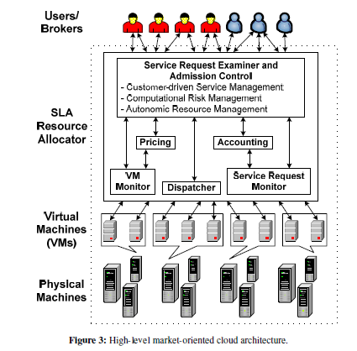

Slide 45
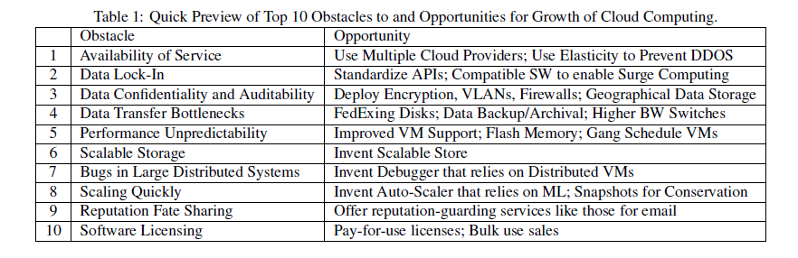

Slide 46
Let’s see more on Cloud!!!

Slide 47


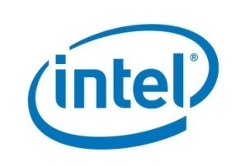
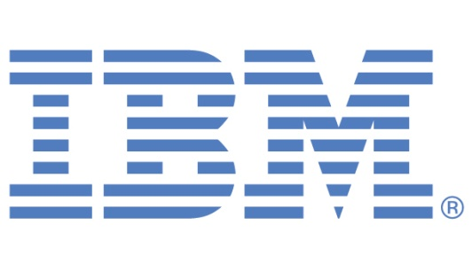

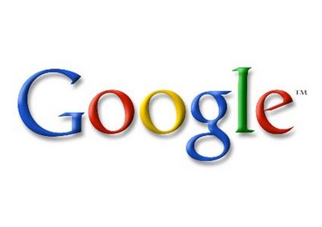
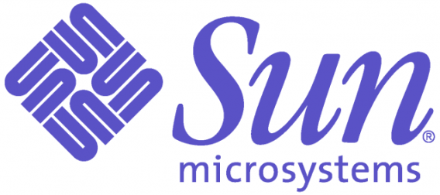


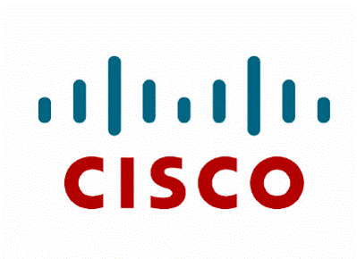

Who is providing the Cloud

Slide 48
The Cost Comparison

Slide 49


Traditional Data Center
Buy the Car

Slide 50



SaaS
Leasing a Car

Slide 51
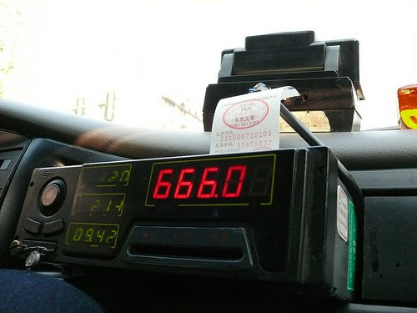
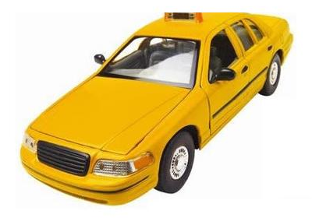
Cloud
Pay as you GO

Slide 52

Traditional IT Cost Model
Users / IT Costs
Growth Scenario
Time

Slide 53
Cloud Computing Cost Model
IT Costs are Variable
Users / IT Costs
Growth Scenario
Time

Slide 54
Traditional IT Cost Model
IT Costs are Semi-Fixed
Users / IT Costs
Recession Scenario
Time

Slide 55
Cloud Computing Cost Model
Users / IT Costs
Recession Scenario
Time

Slide 56
Finally: Cloud Advantages
Lower computer costs
Improved performance
Unlimited storage capacity
Device independence
Availability

Slide 57
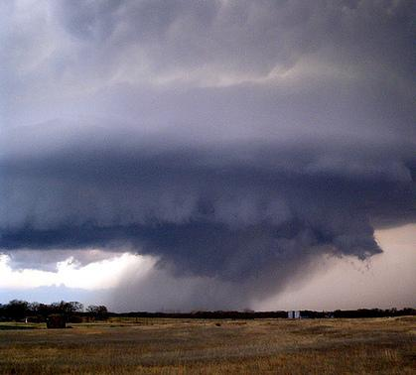
Issues…
Requires a constant Internet connection
Security & Privacy
Legal Issues
Political Issues
Related Bandwidth Cost
Transparency

Slide 58
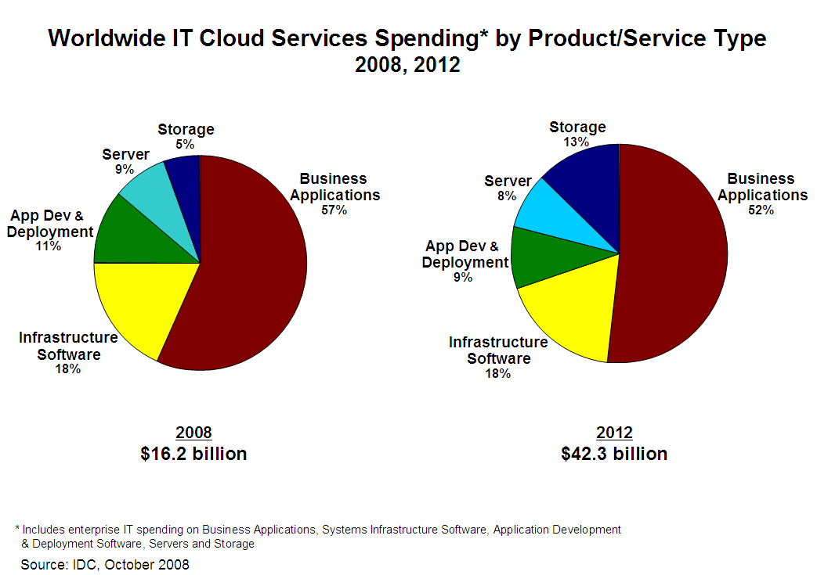

Slide 59
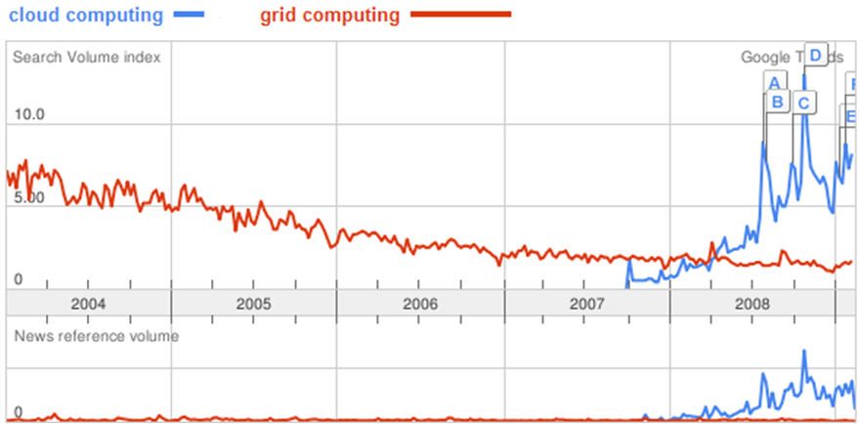
Google Trends…

Slide 60
Conclusion
Cloud computing is an approach to provide all resources as a service
It is an emerging technology
There are still so many unanswered questions.

